Slide 1

Recommendation of OFF-CAMPUS housing for international students based on preferences
By Badreesh, Ishan, Samar, Yash
Group 4

Slide 2

OVERVIEW
Business Problem – Challenges faced by international students with respect to off-campus housing
Recommendation of OFF-CAMPUS housing for international students based on preferences – The reason to go for this topic is based on a lot of international students having trouble looking for relevant housing. This would be a useful tool not just for international students but also for others as it will analyze where students tend to stay and the location where to stay; brokers don’t share the data regarding safety, as they are only interested in the broking fees.
This is important to analyze the best location for students to stay and the recommendations for the same to help them with the kind of location individuals would like to stay in.
This is mainly for students who are on a budget as well as who would like to reside in a neighborhood following on their liking and preferences.
This is a unique proposition as it allows students to focus on the preferences they are looking for such as Rent Bracket
(Sarkar and Roychowdhury, 2019)
(McGregor, 2021)

Slide 3
DATA COLLECTION
Primary Dataset
Survey Conducted (162 rows, 37 columns)
Secondary Datasets
Crime Data (ANALYZE BOSTON) (58429 rows and 17 columns)
Hospital Data (ANALYZE BOSTON) (3030 rows and 14 columns)
Restaurant Data (ANALYZE BOSTON) (26 rows 7 columns)
Housing Rent Data (Zillow – Web scraping) (400 rows and 47 columns)

Slide 4
TOOLS UTILIZED
TABLEAU
PYTHON
EXCEL

Slide 5
DATA PRE-PROCESSING
DATA FORMATTING
Unit level of analysis – Individual
DATA PROFILING
Understanding the data
DATA CLEANING
Removal of null values
Impute missing values
Feature Engineering (COUNT)
Structured Data – Primary dataset
Unstructured Data – Secondary Dataset

Slide 6
DATA FORMATING & DATA PROFILING
Primary Data and Secondary Data
Normalized Irregular Names
Corrected incorrect entries
Check for cardinalities
Mitigated data discrepancies
Renaming of columns
Normalized names to match a common value (Eg: “data” and “Data” are the same, so we normalized both as ”Data”
EXCEL, PYTHON
(Sarkar and Roychowdhury, 2019)

Slide 7
DATABASE MODEL
Crime_table
Neighborhood
crime_cnt
…...
Primary_df Table
Neighborhood
University
Housing Situation
Rent_bk
Utilities_bk
Utilities_szt
Groceries_bk
Share_cnt
Privateroom_st
Housing_type
Ethnicity
Gender
Transportation
Dist_uni
Shuttle_service
Restaurant_st
Grocieries_st
Restaurant_table
Neighborhood
restaurant_cnt
…..
Neighborhood_info Table
Neighborhood
crime_cnt
restaurant_cnt
hospital_cnt
rent_prices
Hospital_table
Neighborhood
hospital_cnt
…....
Rent_table
Neighborhood
rent_cnt
…....

Slide 8
DATA CLEANING AND IMPUTATION
Primary data - EXCEL
Removal of unrelated columns
Replace Null and missing values with “no answers given”
Secondary Data (Crime, Hospital, Restaurant) - Python
Removing Latitude and Latitude having null and empty values
Converting Zipcodes and Latitude, Longitude to relevant datatypes
Scraping Boston Rent Data from Zillow and removed empty priced apartments
Imputing Neighborhood into the Dataset using Geopy reverse encoding

Slide 9
TOOLS & PACKAGES UTILIZED IN PYTHON
For building web-app
Data analysis and wrangling
Plotly
Data visualization
Folium
Map building
RapidFuzz
Similarity check
Geopy
Determining location/neighborhood
Streamlit
Pandas

Slide 10
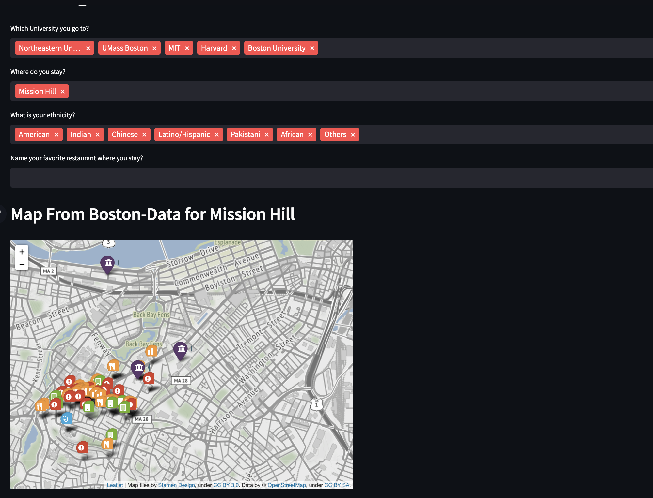
DATA VISUALIZATION – STREAMLIT https://housing-streamlit-heroku.herokuapp.com/
Crime, Hospital, Restaurant Visualization based on user input for neighborhood
Zillow Price Heatmap around the locality
Crime Shooting Heatmap around the locality
Count of Crimes, Hospitals, Restaurants

Slide 11
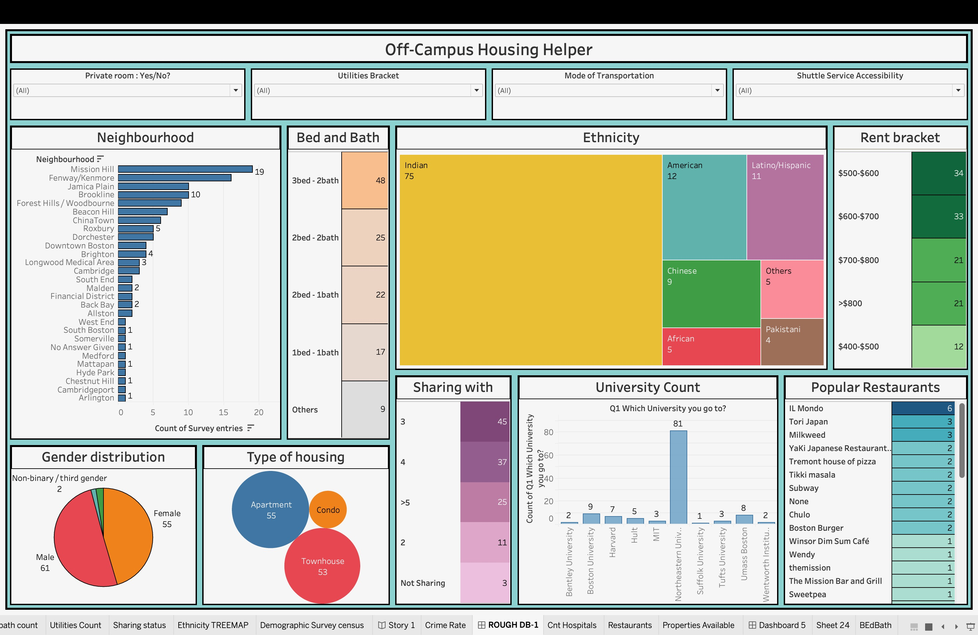
DATA VISUALIZATION - TABLEAU
Demographic visualization based on survey input data.
Ethnicity concentration based on survey data
Conditional filtering based on visualization and chosen elements
Based on survey, recommendation of most popular restaurants
All-comprehensive dashboard built upon filtering and selection.

Slide 12
DATA ANALYSIS
Used feature engineering for dashboarding and visualizing
Inferences drawn from TABLEAU dashboard
Challenges
Information Quality
Data Sufficiency
Data Accuracy
Data merging, as the Foreign key was not fully identical.

Slide 13

IMPROVEMENT IF THEIR WAS MORE TIME
If there was more time, data that have not been found with respect to neighborhoods could have been added via other datasets or scraping.
The Tools could have been merged as a plotly-dash and streamlit web-app.
Machine Learning tools could have been utilized for recommending students properties.

Slide 14


DEMO
Streamlit
TABLEAU

Slide 15
REFERENCES
Practical Python Data Wrangling and Data Quality, December 2021, Susan E. McGregor, O'Reilly Media, Inc. ISBN: 9781492091509
Data Wrangling with Python, February 2019, Dr. Tirthajyoti Sarkar, Shubhadeep Roychowdhury, Packt Publishing. ISBN: 9781789800111
https://data.boston.gov/dataset/active-food-establishment-licenses
https://data.boston.gov/dataset/hospital-locations
https://data.boston.gov/dataset/boston-buildings-inventory
https://data.boston.gov/dataset/crime-incident-reports-august-2015-to-date-source-new-system

Slide 16
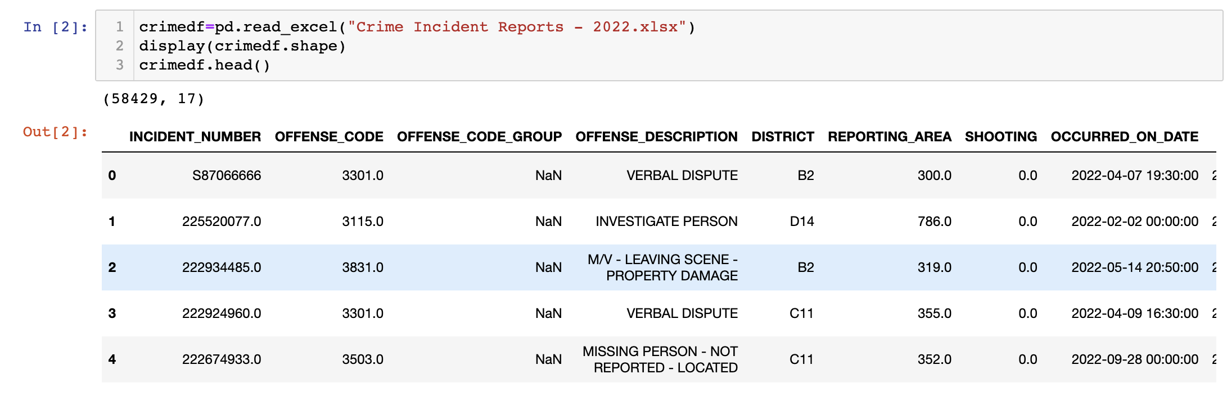
Appendices
Appendix 1 – RAW DATA (PYTHON – Secondary Data)

Slide 17
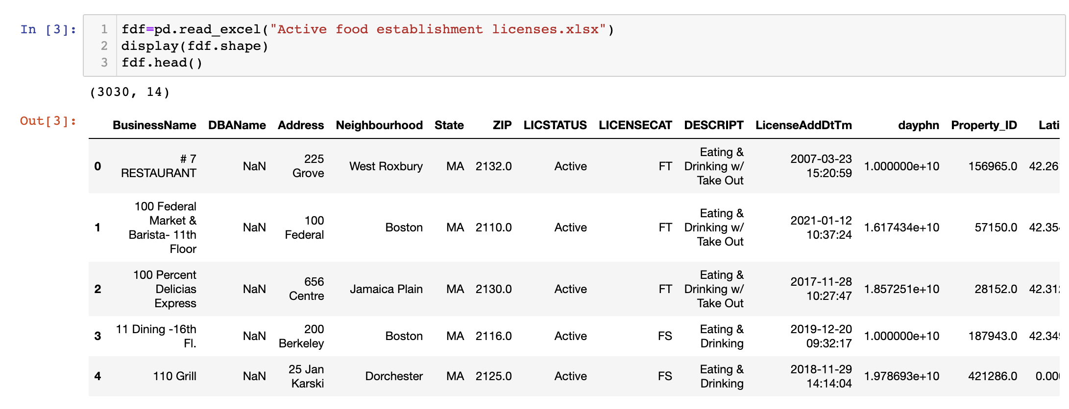
Appendix 3 – RAW DATA (PYTHON – Secondary Data)

Slide 18
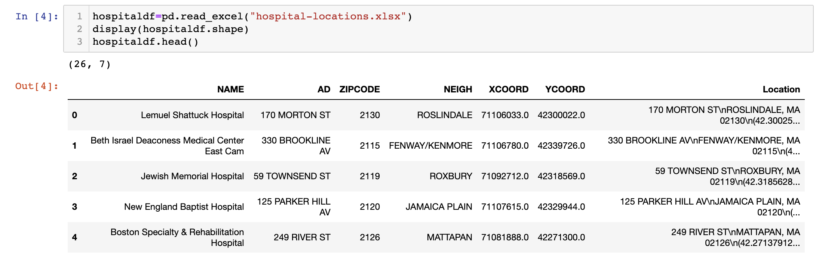
Appendix 3 – RAW DATA

Slide 19
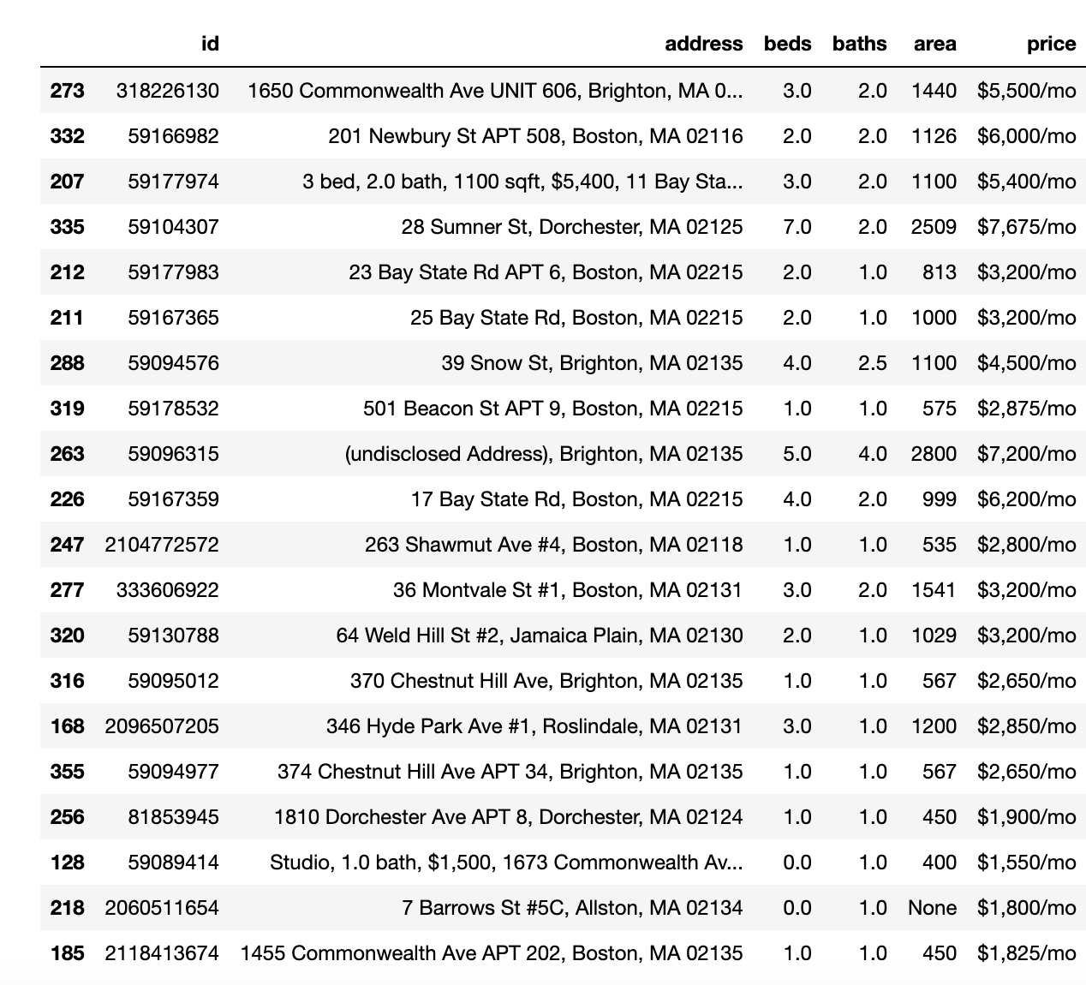
Appendix 4 – RAW DATA

Slide 20
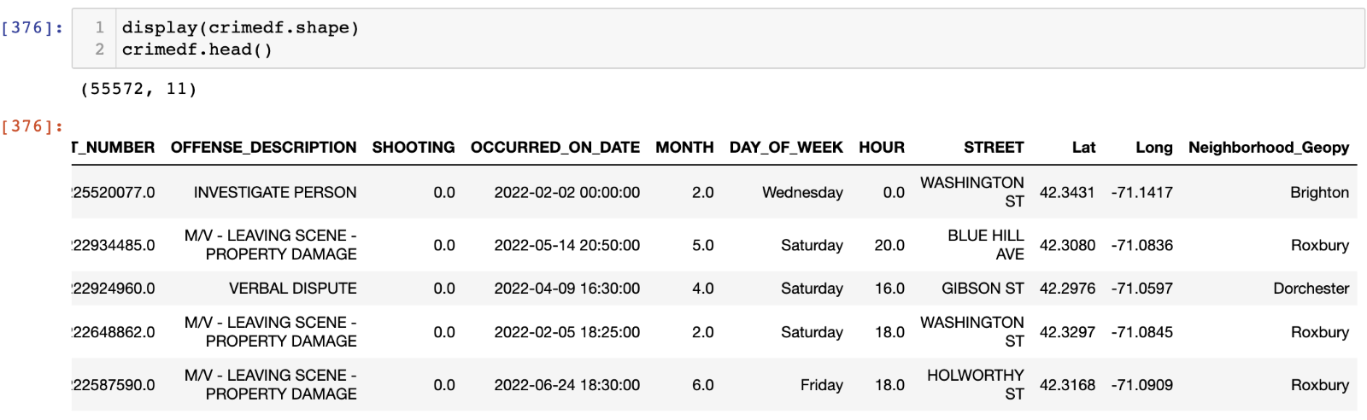
Appendix 5 – CLEAN DATA (PYTHON – Secondary Data)

Slide 21
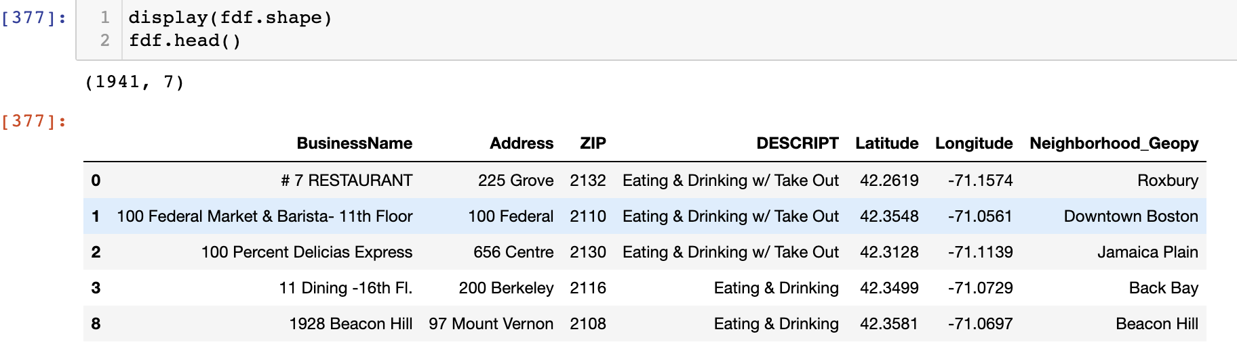
Appendix 6 – CLEAN DATA (PYTHON – Secondary Data)

Slide 22
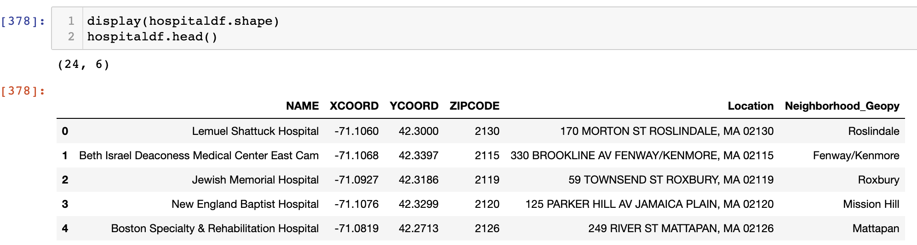
Appendix 7 – CLEAN DATA (PYTHON – Secondary Data)

Slide 23
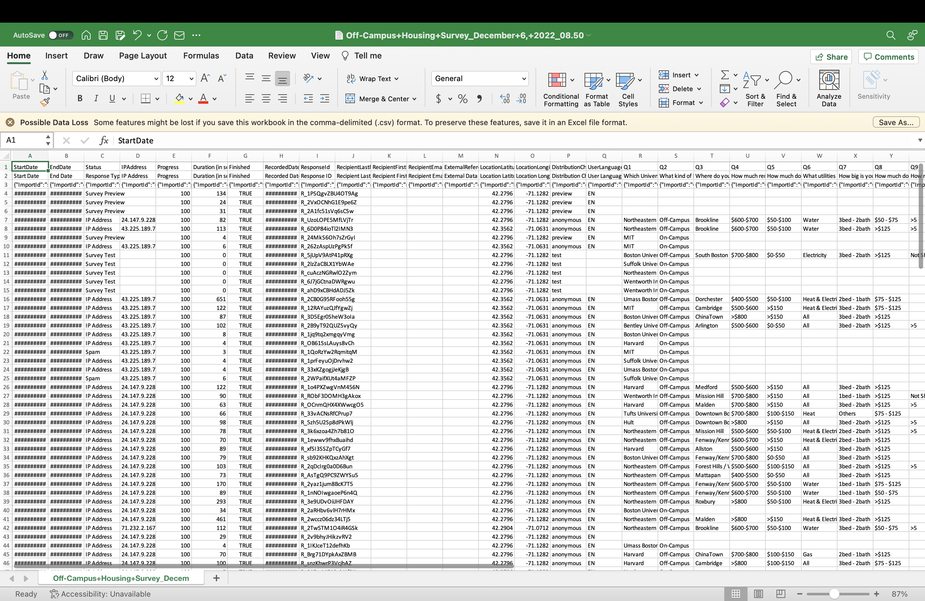
Appendix 8 – Raw Survey (Excel – Secondary Data)

Slide 24
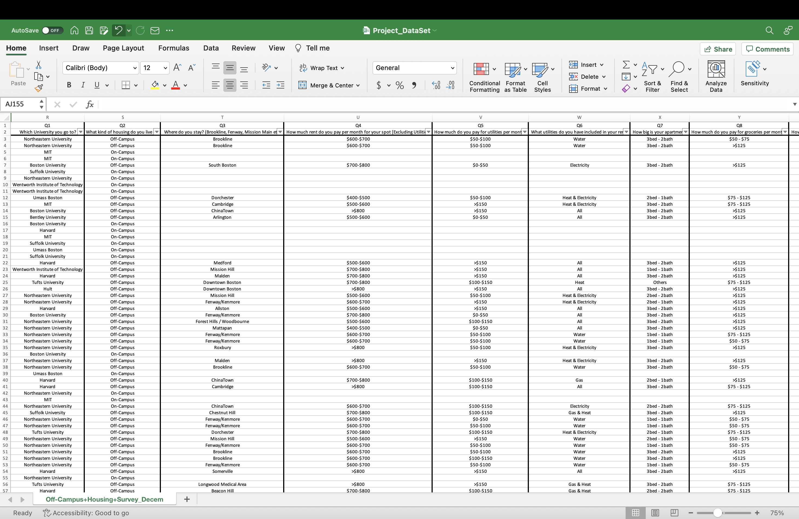
Appendix 9 – Cleaned Survey ( Excel – Secondary Data)

